Slide 1

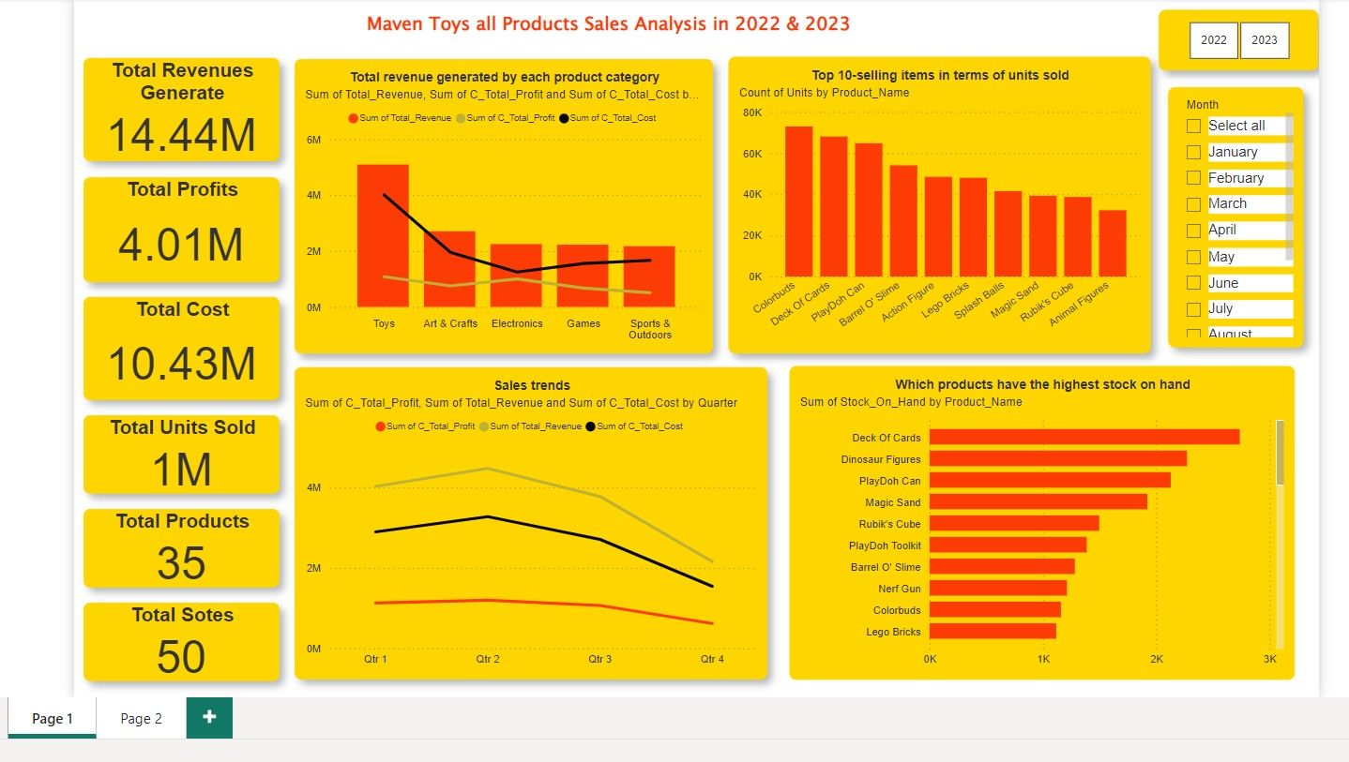

Slide 2
Insights
Overview
Total Revenue: $14.44M across all products.
Total Profit: $4.01M, contributing approximately 27.8% of total revenue.
Total Costs: $10.43M, significantly reducing overall profit margins.
Total Units Sold: 1.09M units over the period.
Category Performance
Revenue Leaders:
Toys: The dominant category, driving the majority of revenue.
Art & Crafts: Second highest contributor to revenue.
Electronics: Third largest contributor.
Profitability:
Electronics: Achieved the highest profit margin compared to all other categories, making it the most profitable segment.

Slide 3
Insights
Revenue in 2023 decreased by ₹527,425.63 compared to 2022.
Profit in 2023 saw a decline of ₹366,545.00, indicating a need to optimize operational costs and improve revenue streams.
The top-selling items include Colorbuds, Deck of Cards, PlayDoh Can, Barrel O' Slime, and Action Figures.
Sales drop significantly in Quarter 3 and Quarter 4, highlighting a clear seasonal dip in demand.
Addressing this decline could stabilize annual revenue and profit margins.

Slide 4
Product Category Insight
Best Performing Product Category
Art & Crafts Revenue nearly doubled from ₹906,640.90 in 2022 to ₹1,798,723.38 in 2023 (+98.3%). and Profit increased by ₹207,456.00 (+76%).
Worst Performing Product Category
Electronics Revenue declined significantly from ₹1,440,459.00 to ₹806,312.06 (-44%). and Profit decline by ₹347,377.00 (-51.5%).
Games Revenue decreased from ₹1,228,644.00 to ₹998,192.68 (-18.7%). and Profit decline by ₹82,769.00 (-21.9%).
Sports & Outdoors Revenue decreased slightly from ₹1,119,428.00 to ₹1,052,931.70 (-5.9%). and Profit decline marginally by ₹4,334.00 (-1.7%).
Toys: Revenue declined by ₹481,412.55 (-17.3%). and Profit decreased by ₹138,521.00 (-22.7%).

Slide 5
Product Category Insight
Product Category | Total Revenue | % of Total Revenue | Total Profit | Profit Margin
Art & Crafts | ₹2,705,364.26 | 18.74% | ₹753,354.00 | 27.84%
Electronics | ₹2,246,771.25 | 15.56% | ₹1,001,437.00 | 44.57%
Games | ₹2,226,836.27 | 15.42% | ₹673,993.00 | 30.26%
Sports & Outdoors | ₹2,172,359.57 | 15.06% | ₹505,718.00 | 23.28%
Toys | ₹5,093,241.00 | 35.22% | ₹1,079,527.00 | 21.21%

Slide 6
Overall Quarterly Revenue Summary
Quarter 2 is the highest-performing quarter, contributing 28.79% of total revenue.
Quarter 4 shows a significant revenue drop, contributing only 13.74%, indicating a need for strategic interventions.
Combined revenue for Quarters 1 and 2 accounts for 54.7% of the total, showing stronger performance in the first half of the year.
Quarter | Total Revenue | Revenue Contribution (%)
Qtr 1 | ₹4,027,736.9 | 25.91%
Qtr 2 | ₹4,473,733.5 | 28.79%
Qtr 3 | ₹3,681,721.6 | 23.71%
Qtr 4 | ₹2,134,382.2 | 13.74%

Slide 7
Revenue Analysis by Store Location
Downtown:
Dominates revenue generation, contributing 52.82% of total revenue.
Quarter 2 is the peak (₹2.53M), followed by a decline in Quarters 3 and 4.
Commercial:
Second-highest contributor with 21.09% of total revenue.
Consistent performance in Quarters 1 and 2, but Quarter 4 sees a 43% drop compared to Quarter 2.
Residential:
Contributes 10.64% of total revenue, maintaining stable performance in Quarters 1 and 2.
Revenue declines sharply in Quarter 4 (48% from Quarter 2).
Airport:
Smallest revenue contributor (8.29% of total revenue).
Quarter 2 records the highest revenue (₹416K) due to potential seasonal demand. Quarter 4 revenue drops significantly (55% from Q2).

Slide 8
Revenue Analysis by Store Location
Store Location | Qtr 1 Revenue | Qtr 2 Revenue | Qtr 3 Revenue | Qtr 4 Revenue | Total Revenue | Contribution (%)
Airport | ₹334,904.7 | ₹416,051.8 | ₹353,577.7 | ₹185,188.3 | ₹1,289,722.5 | 8.29%
Commercial | ₹895,762.0 | ₹1,037,049.0 | ₹859,236.1 | ₹487,092.7 | ₹3,279,139.8 | 21.09%
Downtown | ₹2,320,498.0 | ₹2,531,000.0 | ₹2,132,954.0 | ₹1,235,145.0 | ₹8,219,597.0 | 52.82%
Residential | ₹475,571.2 | ₹492,632.7 | ₹432,953.8 | ₹254,956.2 | ₹1,656,114.0 | 10.64%

Slide 9
Quarterly Revenue Comparison by Store Location
Quarter 1
Downtown dominates with ₹2.32M, contributing 57.6% of Q1 revenue.
Commercial is the second-largest, contributing ₹895K (22.2%).
Residential and Airport contribute 11.8% and 8.3%, respectively.
Quarter 2
Downtown leads again, generating ₹2.53M (56.6%).
Commercial shows strong growth with ₹1.04M (23.2%).
Residential and Airport maintain smaller shares, with 11% and 9.3%, respectively.
Quarter 3
Downtown retains the lead with ₹2.13M (57.9%), but revenue declines compared to Q2.
Commercial contributes ₹859K (23.3%), showing a similar trend.
Residential and Airport follow with 11.8% and 9.6%, respectively.
Quarter 4
Downtown remains the leader but experiences a significant drop to ₹1.23M (57.9% of Q4 revenue).
Commercial follows at ₹487K (22.8%), with a steep decline from earlier quarters.
Residential and Airport record their lowest revenues, contributing 11.9% and 8.7%, respectively.

Slide 10
Revenue Trends by Store Location
Store Location | Revenue Growth/Decline by Quarter | Key Observations
Airport | Q1 → Q2: +24.2% Q2 → Q3: -15.0% Q3 → Q4: -47.6% | Strong performance in Q2, but revenues plummet in Q4. Targeted marketing during off-peak periods may help stabilize revenue.
Commercial | Q1 → Q2: +15.8% Q2 → Q3: -17.1% Q3 → Q4: -43.3% | Revenue peaks in Q2 but shows a sharp decline in Q3 and Q4. Retention strategies and seasonal promotions are needed.
Downtown | Q1 → Q2: +9.1% Q2 → Q3: -15.7% Q3 → Q4: -42.1% | Downtown consistently outperforms other locations but suffers a major decline in Q4. Mid-year and year-end strategies could improve sustainability.
Residential | Q1 → Q2: +3.6% Q2 → Q3: -12.1% Q3 → Q4: -41.1% | Stable growth in Q2 but sharp declines in Q3 and Q4. Engaging local customers and exploring niche opportunities might help.

Slide 11
Recommendations
Implement year-end promotions or discounts, particularly for Airport and Commercial locations, to combat seasonal revenue declines.
Introduce premium services or products in Downtown locations to capitalize on its leading market share.
Analyze reasons for the sharp Q3 and Q4 decline. Introduce customer loyalty programs or quarterly sales campaigns to retain customers.

Slide 12
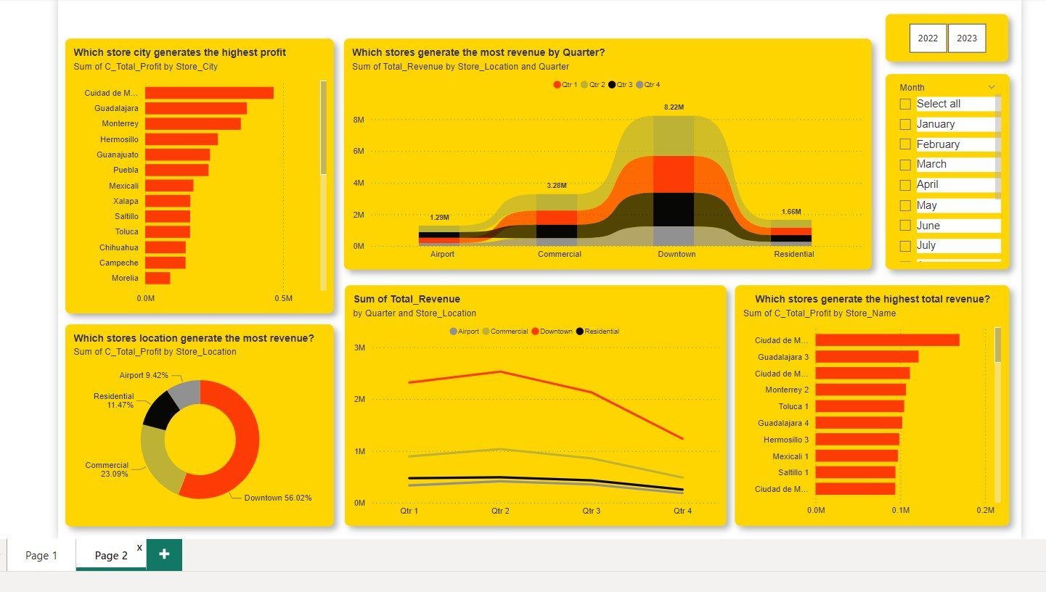

Slide 13
Monthly Trends
The Downtown location consistently generated the highest revenue across all months, with the highest revenue in April ($851,483.5) and the lowest in October ($345,817.3). It contributing 56%-58% to the total revenue in each quarter.
The Commercial location had the second-highest revenue, with the highest in April ($353,732.9) and the lowest in October ($147,398.3). contributing 22%-23%.
The Residential location had the third-highest revenue, with the highest in March ($187,309.1) and the lowest in October ($73,847.28). averaging around 11%
The Airport location had the lowest revenue, with the highest in July ($154,151.1) and the lowest in October ($56,811.57). averaging around 9%

Slide 14
Seasonal Patterns
All store locations showed a similar seasonal pattern, with higher revenues in the spring and summer months (March to July) and lower revenues in the fall and winter months (October to December).
The Downtown location had the most pronounced seasonal fluctuations, with revenue peaking in April/May and declining significantly in the final quarter of the year.
The Commercial and Residential locations also exhibited seasonal trends, but with less dramatic variations compared to the Downtown location.
The Airport location had the least pronounced seasonal patterns, but still saw a decline in revenue during the final quarter.

Slide 15
Performance by Store Location
Airport
Best Month: July (₹154,151.1) – Likely due to increased seasonal travel.
Lowest Month: October (₹56,811.57) – Indicates a significant drop in demand.
Commercial
Best Month: April (₹353,732.9) – Suggests strong mid-year sales.
Lowest Month: October (₹147,398.3) – Represents the largest monthly drop-off.
Downtown
Best Month: April (₹851,483.5) – Consistently high performance during the second quarter.
Lowest Month: October (₹345,817.3) – Significant decline in Q4.
Residential
Best Month: March (₹187,309.1) – Peaks in Q1, driven by localized demand.
Lowest Month: October (₹73,847.28) – Marks a sharp revenue fall.

Slide 16
Recommendations
Focus on boosting revenues for Airport and Downtown locations in Q4 through seasonal promotions or marketing campaigns.
Introduce holiday sales and incentives to attract more customers in October-November.
Since Downtown consistently outperforms, expand inventory, services, or marketing budgets for this location.
Explore high-margin product categories during peak months like March and April.
Airport: Introduce targeted campaigns during travel-heavy months (e.g., July) to mitigate low revenues in October.
Residential: Focus on local events or promotions to boost footfall, especially during Q4.
Expand staffing, inventory, and promotional budgets for April-June (Q2) and January-March (Q1) to maximize profits during peak quarters.

Slide 17
Thanks!
Do you have any questions?
jatinbhavsar000@gmail.com
+91 9924750166

